Slide 1
Skin Legion Identification and Extraction
By: Jakob Kirby

Slide 2

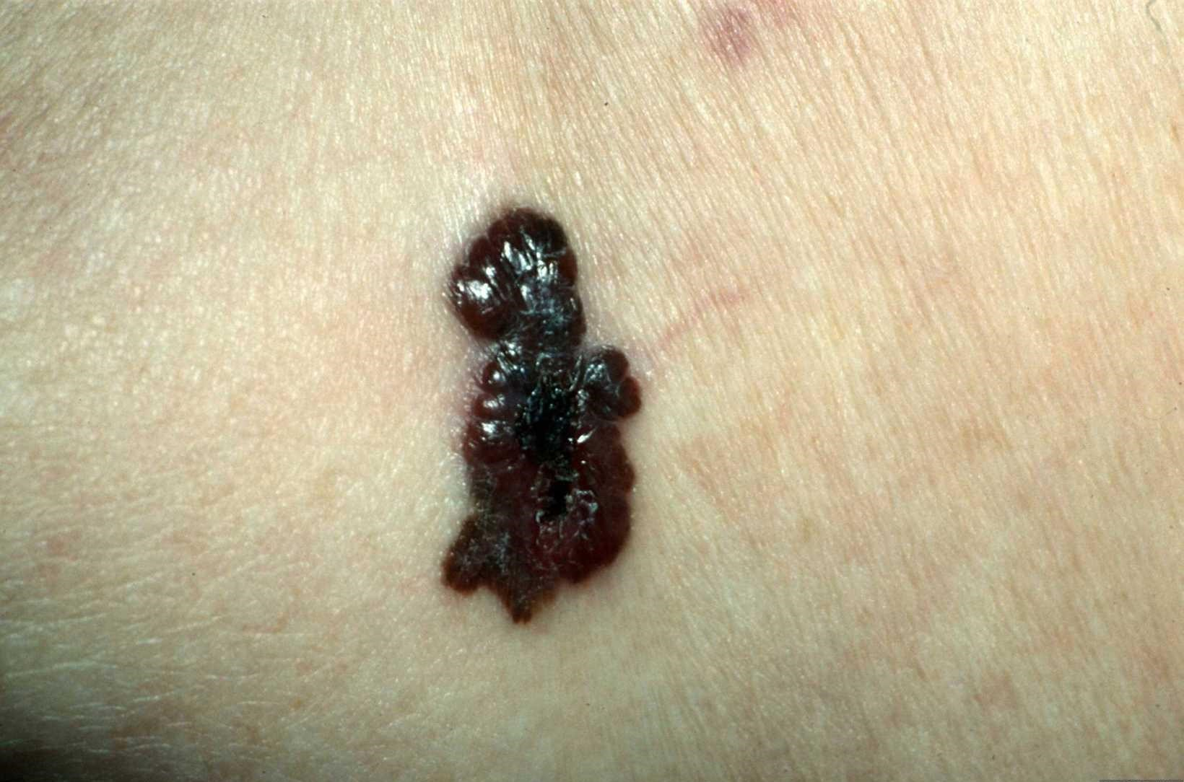
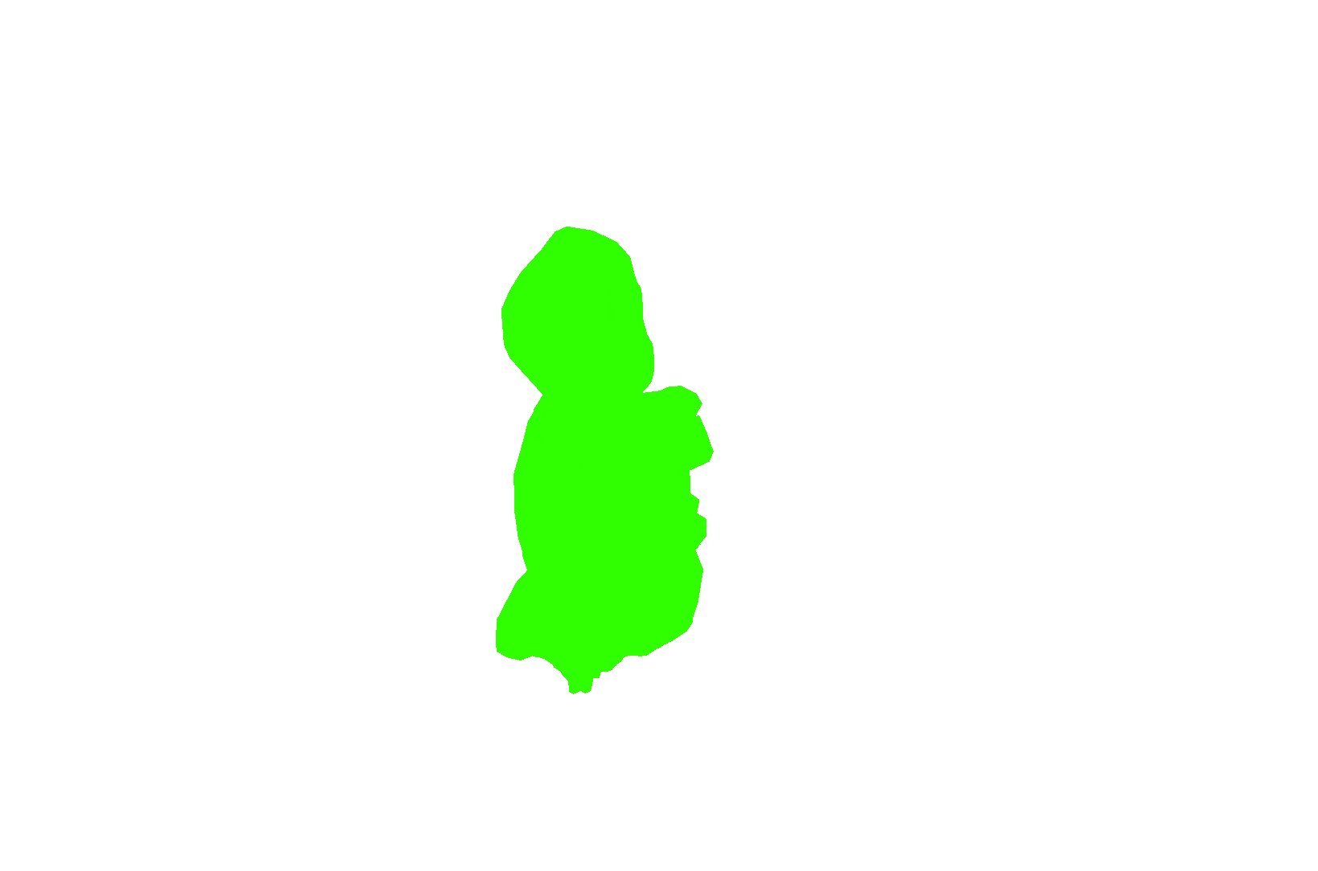
Objective
skin condition analysis and diagnosis falls under the study of Dioscopy.
currently is a manually done process done by human experts.
I wanted to see with this project if I could do extraction upon images of skin diseases and determine if the image extraction features melanoma.

Slide 3
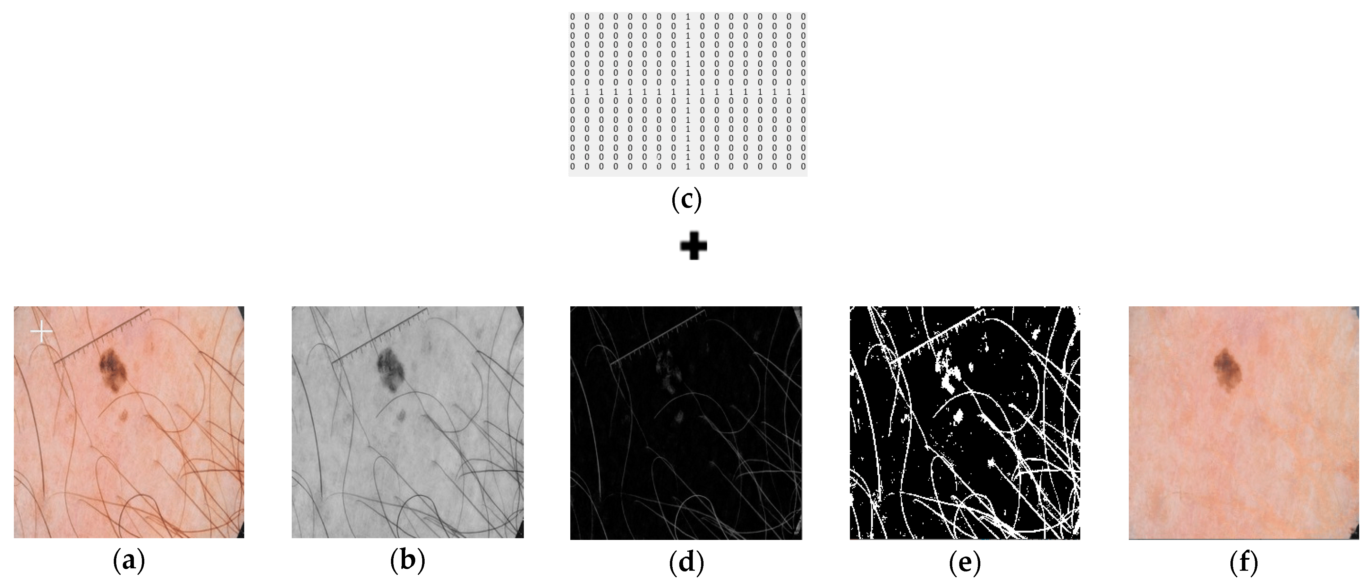
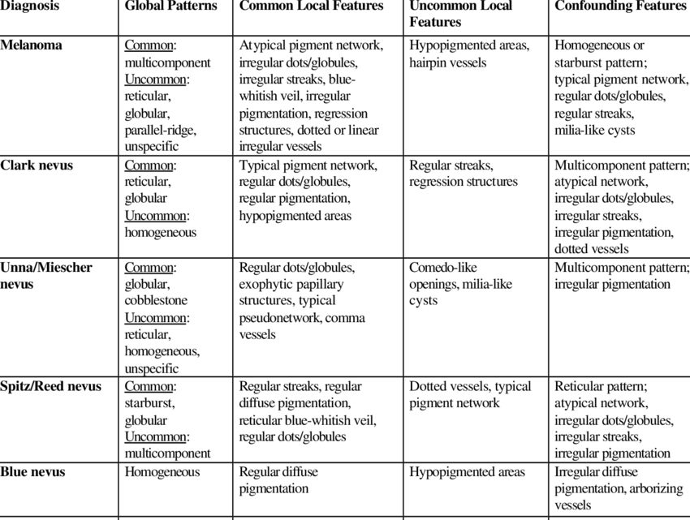
Related Studies
Preparing image for processing
In the study done by Kashan Zafar etal[1] they created a method for identifying tumors a skin lesions using machine learning.
Although I will not use ML I can use a lot of their processes for preparing the image, as well as removing unnecessary noise from an image.
When taking in an image they would first normalize the image then remove all the pixels of the hair in the image to ensure that it would not be confused for the lesions or tumors.
This preparation would help immensely as not only would this help an image processing only method a lot but they also including the equation they used for their blackHat method for identifying the hairs.
Identification of tumors and lesions
In a study done by Rahil Garnavi et al. they created a process for identifying tumors by Histogram based thresholding and color space analysis.[2]
This study would prove immeasurable useful to my project as having a method to identify and segment the tumors and lesions based off of the color space would be incredibly helpful
Along with being very immediate data the study also included the different methods of transferring to the color spaces they used so I can convert over to the XoYoR space.
Along with the data used to identify I can also transition their method of cluster based histogram thresholding as my main method of segmentation
Also intend to use the same evaluation metrics to ensure everything is measured accurately and correctly
Classifications of tumors and lesions
In a study done by H. Peter Soyer et al. They created a method of classifying different tumors and lesions following different steps and algorithms. [3]
Although this study is meant mainly for the medical field it is a major item that I was looking for as I am wanting my system to not only identify the tumor or lesion but I also hope to have them be categorized based off of what possibly it would be diagnosed as.
With the steps they propose in the ABCD of Dermopscopy, 7-point checklist and Menzies’ method I should be able to create a method of classification for classifying the tumors after segmentation

Slide 4
Methods
RGB Image
Hair Removal
RGB To Greyscale
Image Segmentation
Extract using OTSU method
Analysis
Tumor Classification
Clean Mask
Apply mask to image
Final Output
Check characteristics
Classification

Slide 5
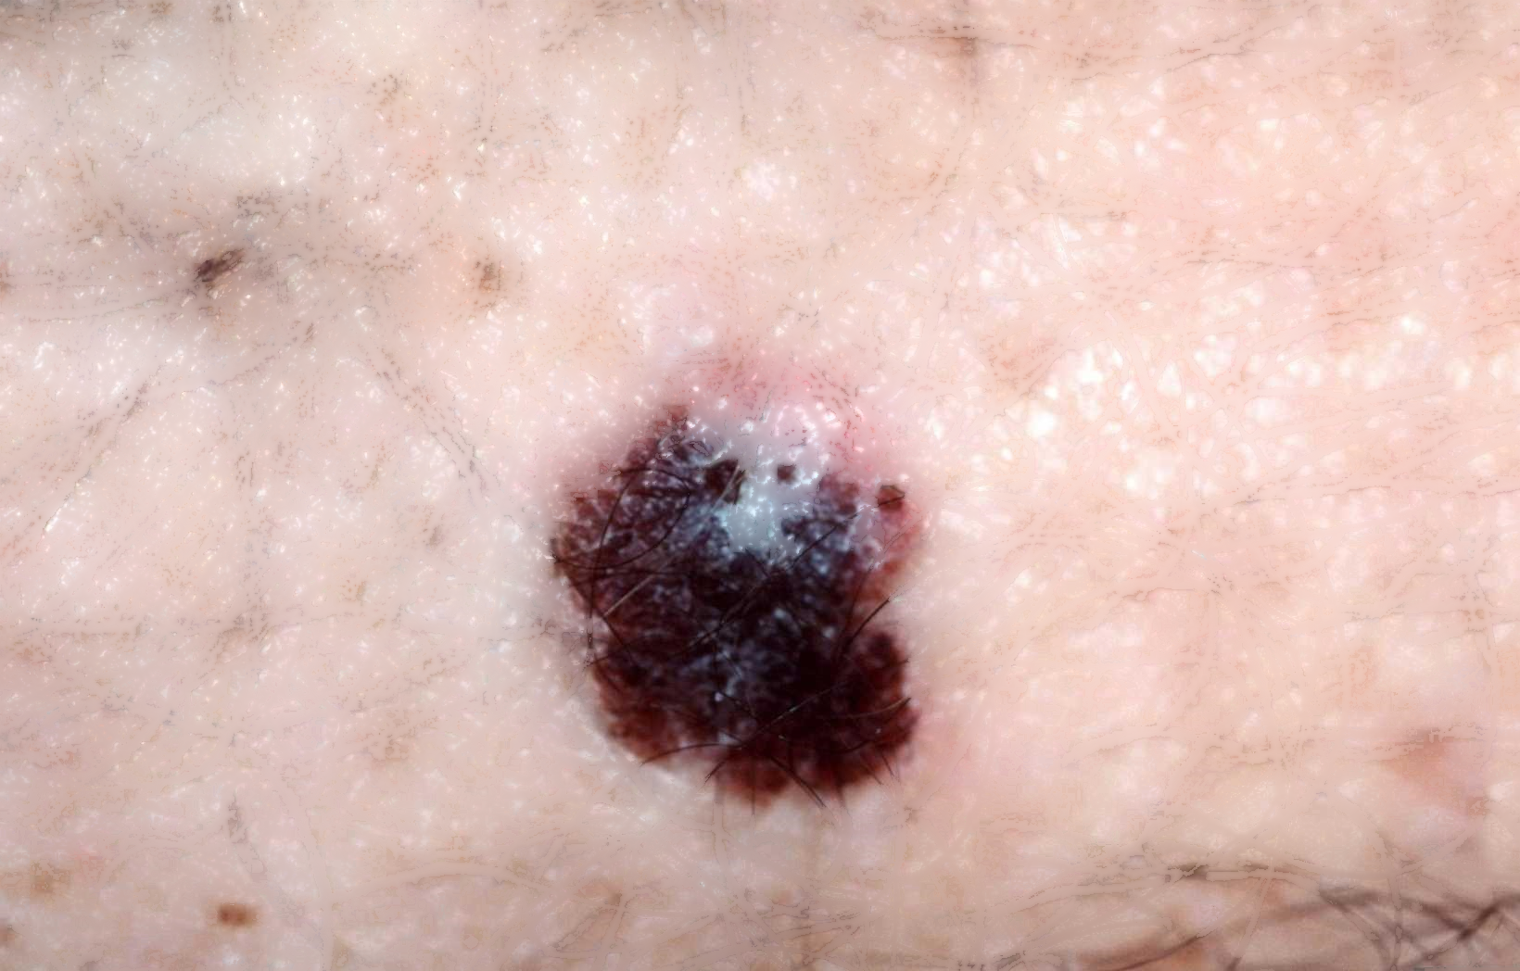
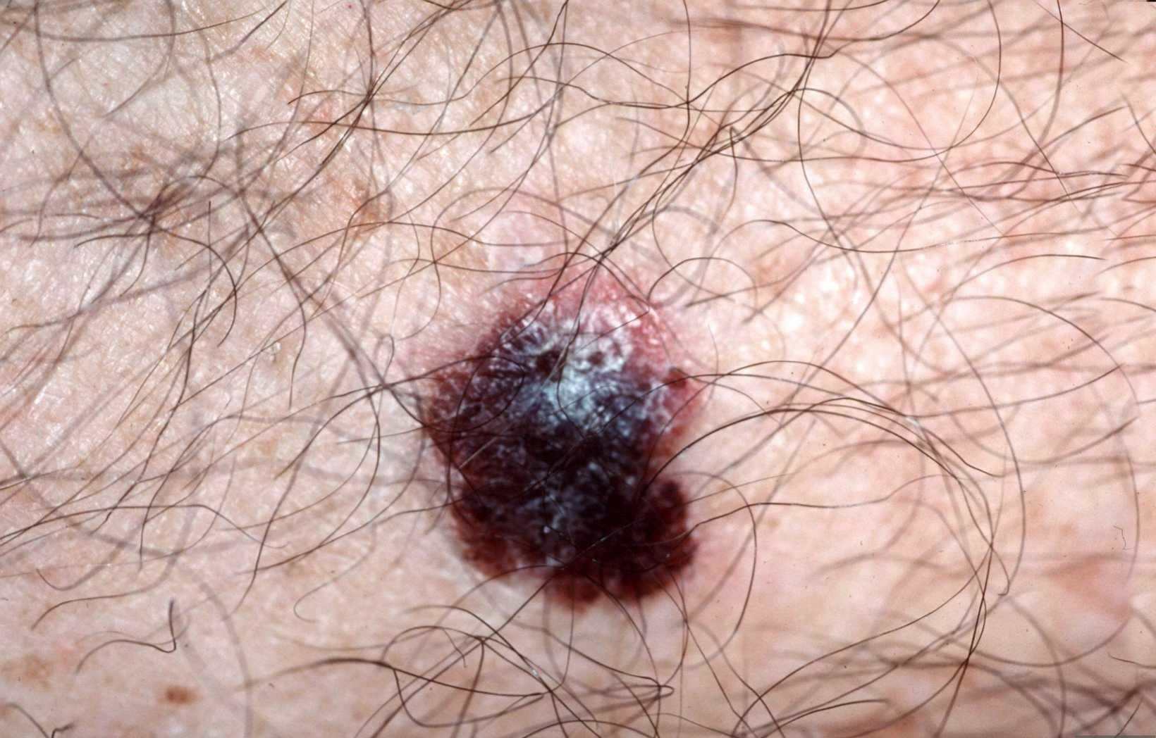
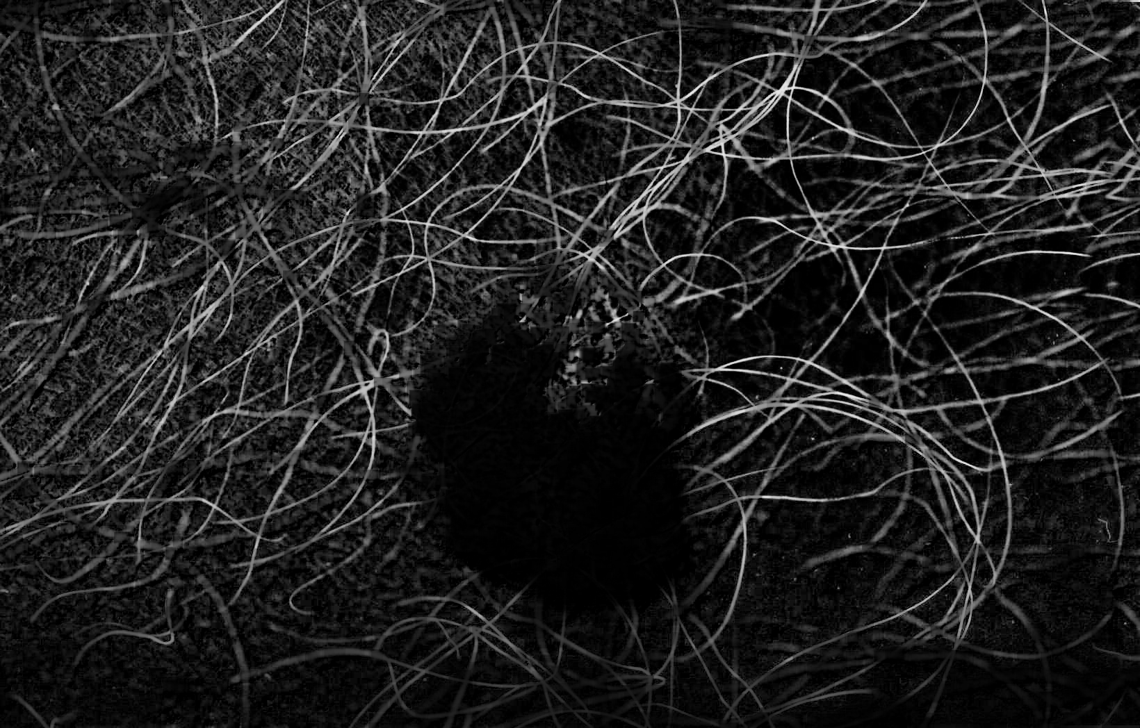
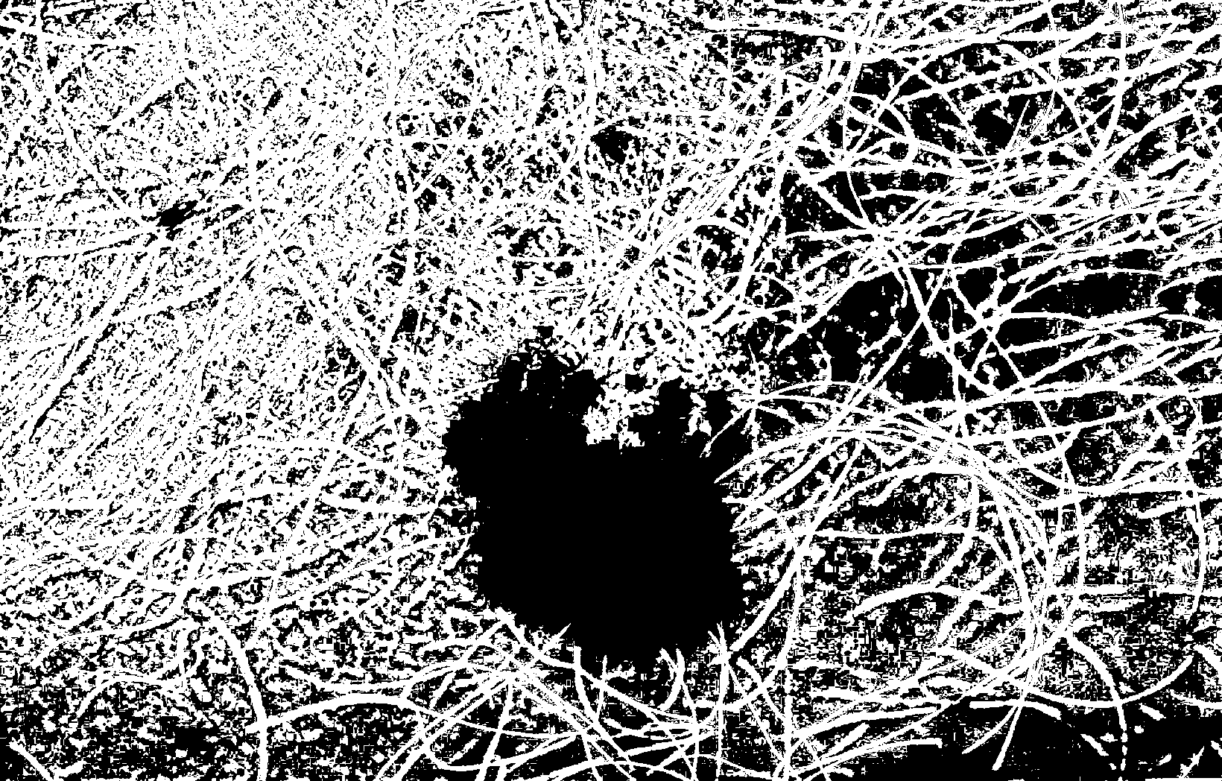
Implementation Process- Preprocessing
Used black hatting to extract the hairs in the image[1]
Had kernal of 14x14
Used the black had and Binary thresh to make mask
Took mask from black hatting and applied it into inpainting
Used a neighbor check size of 20
Applied a gaussian blur to this inpaint to get rid of artifacts from process
Inpaint Final result
Original Blackhat mask

Slide 6
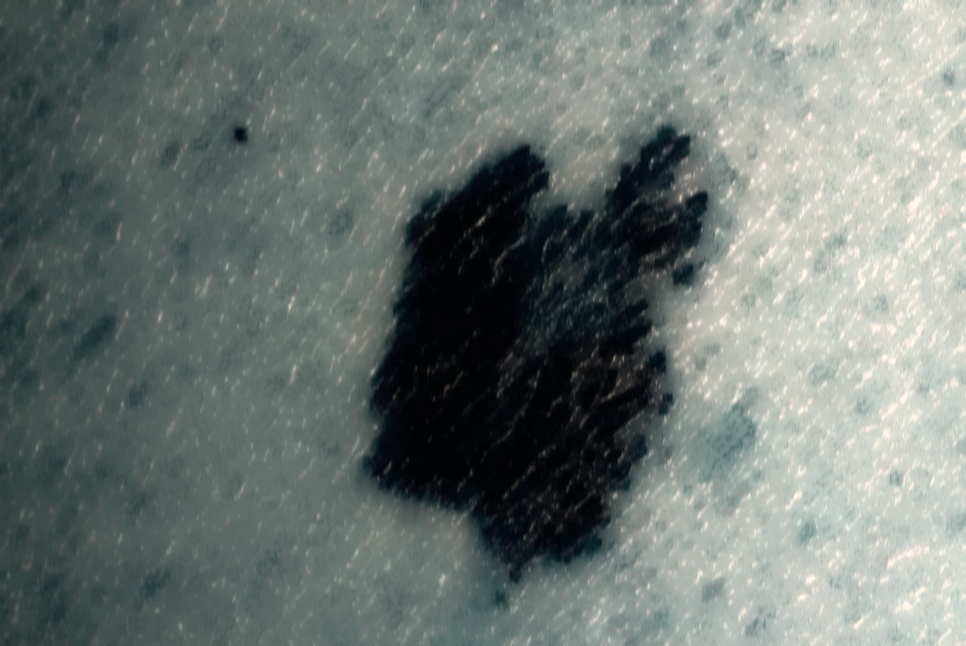
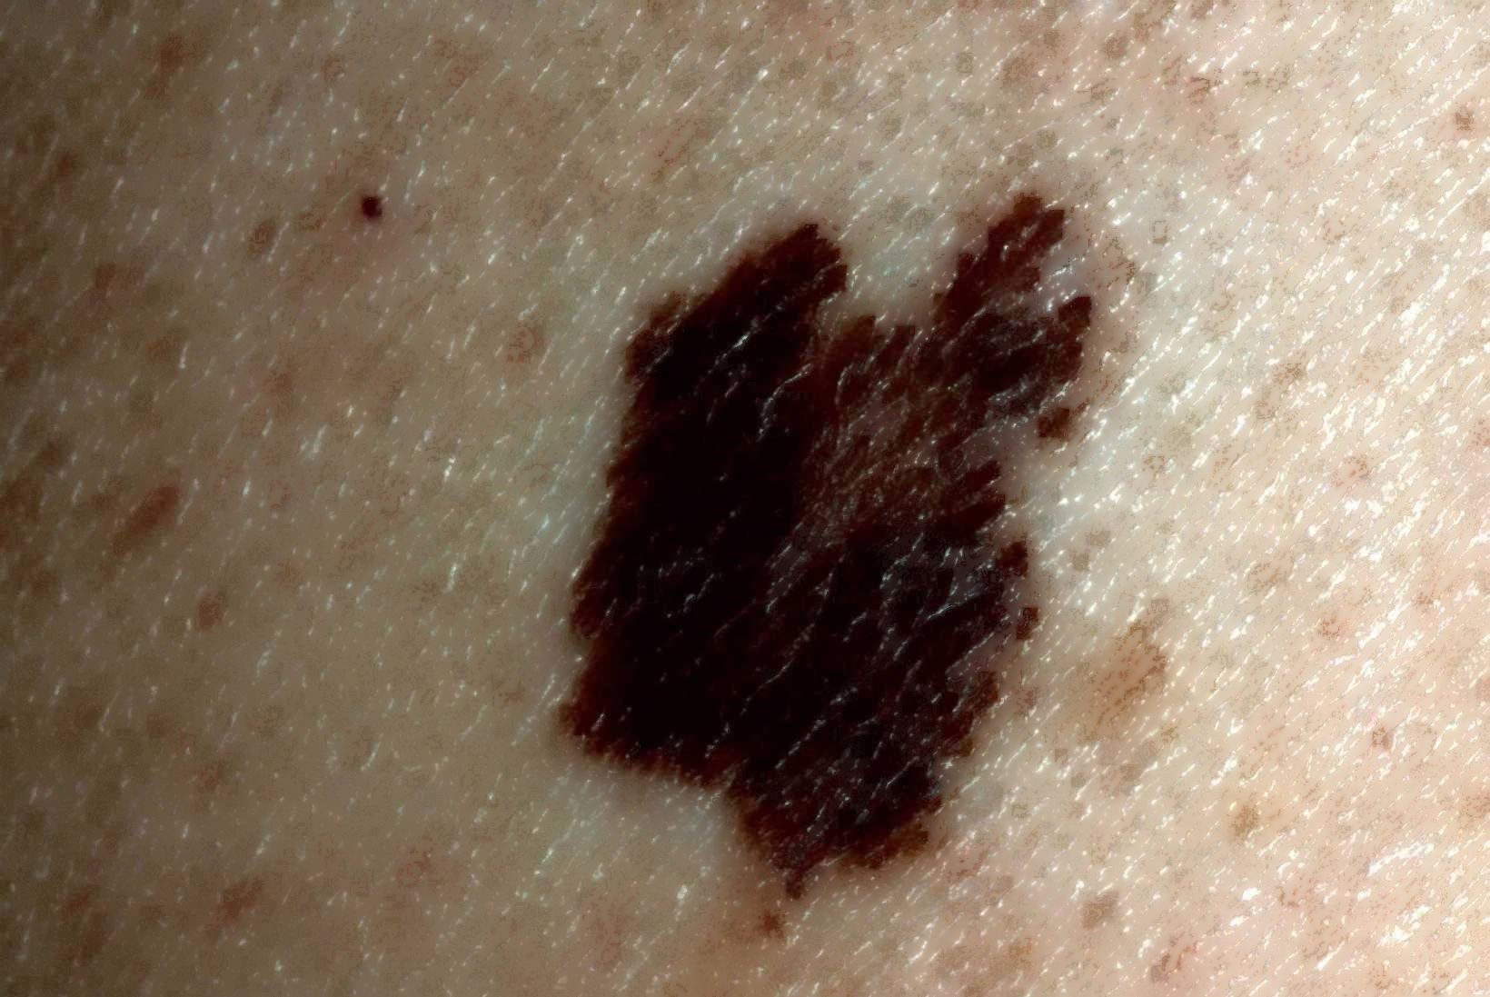
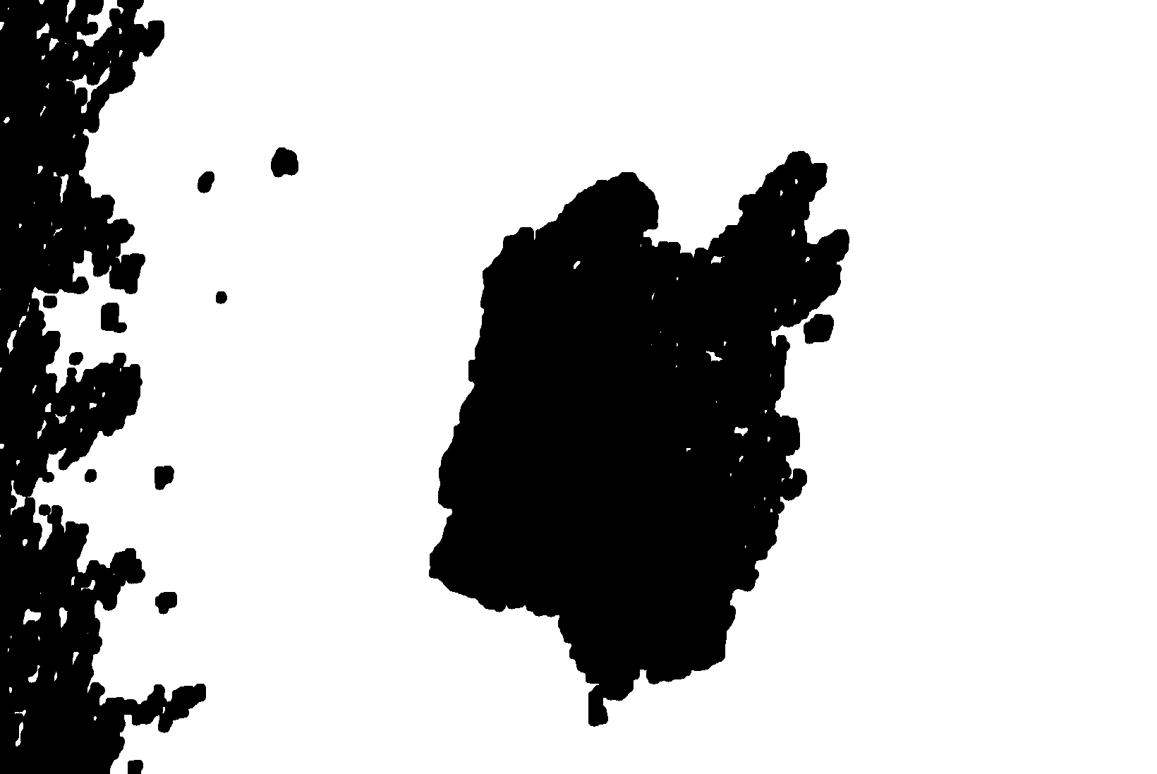
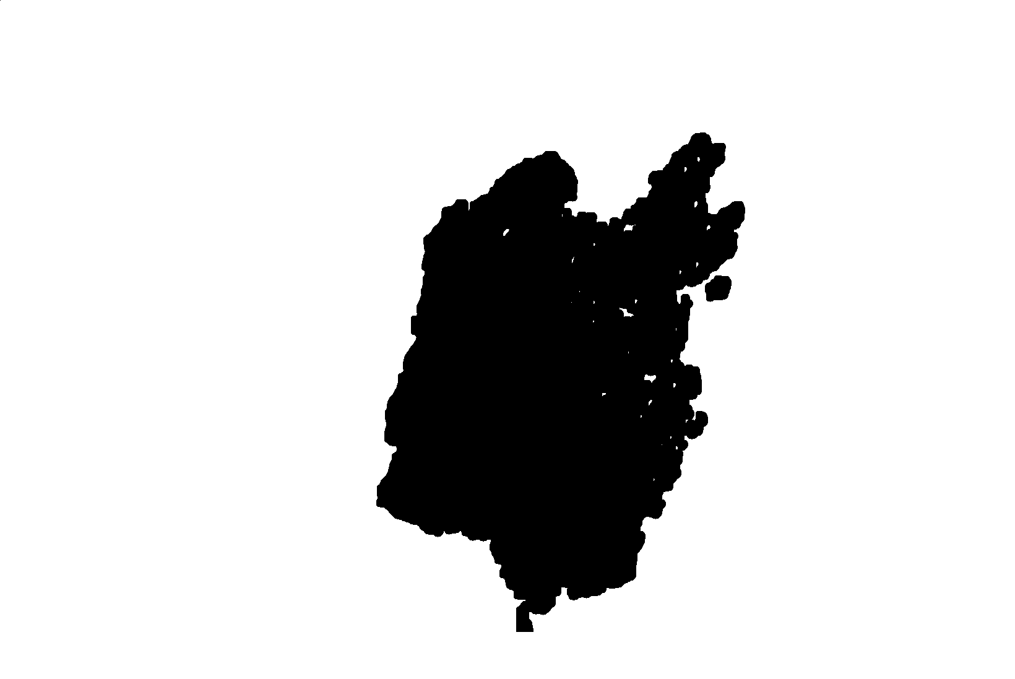
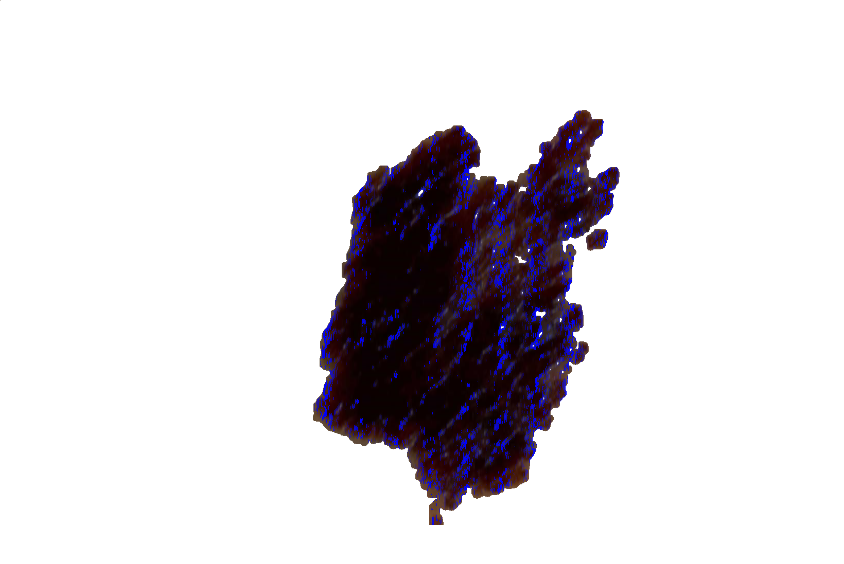
Extraction process
Original plan was to convert to the XYR color space (X,Y, RED)
After trying to use OTSU realized they didn’t just modify it, but instead made a fully new color space implementation
Saw that there was only a 2% dip in accuracy when doing a single color channel[2]
Switched to Grey color space for extraction process
Still made example of what converted image would look like
After extracting a mask using the otsu in combination with binary thresholding to create a mask needed to remove the noise
Used flood fill to fill in the holes in the original mask.
Found that rather than doing dynamic point averaging from the center removing all clusters connected to the edges and past a certain distance from them worked well for removing all artifacts

Slide 7
Diagnosis Process – Pattern decision
First needed to identify what items I could actually measure
A lot of the characteristics were fairly subjective, such as unspecific shapes
Found that some others would need an approach that involved machine learning such as identifying globular/cobblestone patterns.
Also found that a lot of measures would overlap such as parallel ridges and reticular(web-like) patterns
Decided on doing 3 measurements for melanoma
Multicomponent
Pigment Color
Parallel Ridges
These are non-subjective measurements that image processing techniques can find, and allows me to apply definitive labels and patterns to an image
If a image had 2 of these patterns it was labeled and most likely melanoma, and if 3 it was confidently melanoma. Else it was considered confidently NOT melanoma

Slide 8

Diagnosis Process – Implementation Pigments
For the pigment color first, I combined the black color pigments and brown color pigments as one combined pattern to measure for
For the brown I decided on a brown that I took from some of the melanoma images
Had a BRG of <6,10,35>
Would check the 3 point distance from it and measure based off of that. If it was over 35 it would not be counted as dark brown. Same for black
40% of all pixels would need to be black or brown for this pattern to apply

Slide 9
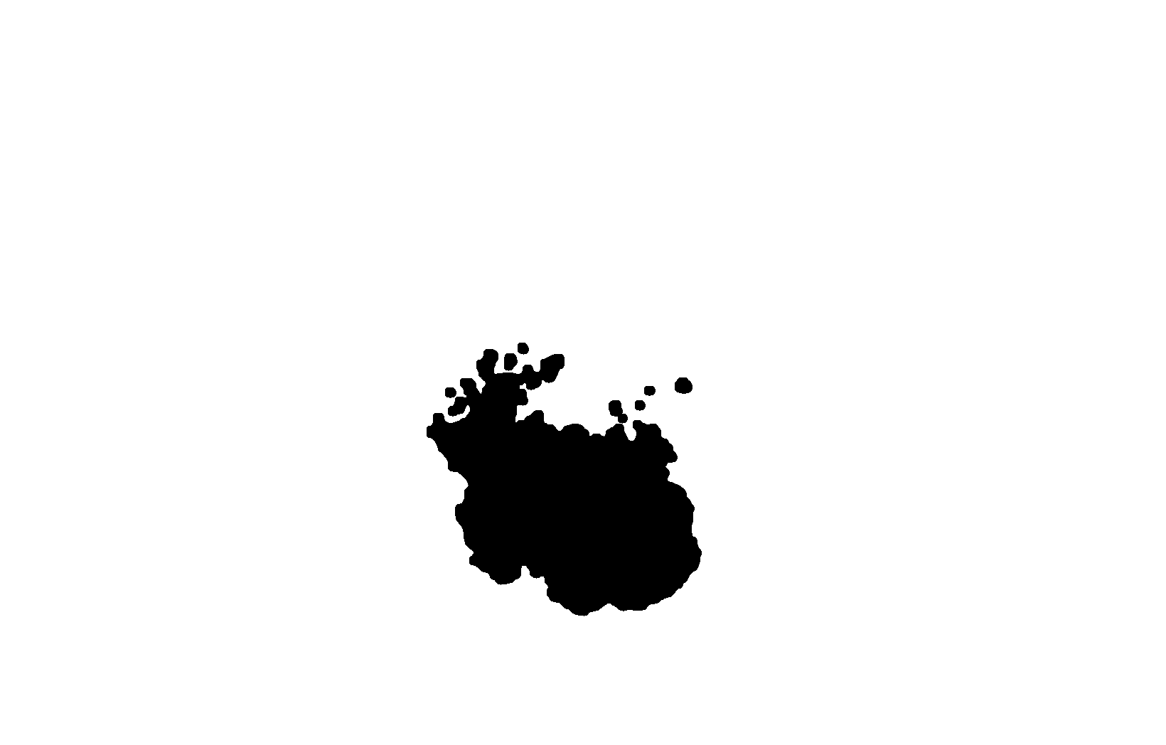
Diagnosis Process – Implementation Multicomponent
This pattern was fairly simple as all I needed to do was check for clusters
Needed to implement a fast and efficient method of finding the clusters
Used method of scanning the mask used to make the extraction and applying it to the parts that were not white.
Counted up each time this happens and I was able to get the number of clusters
With random noise and potential missed fills decided that a extraction must have no more than 4 “clusters” to be considered a multicomponent object, and not just a large amount of points

Slide 10
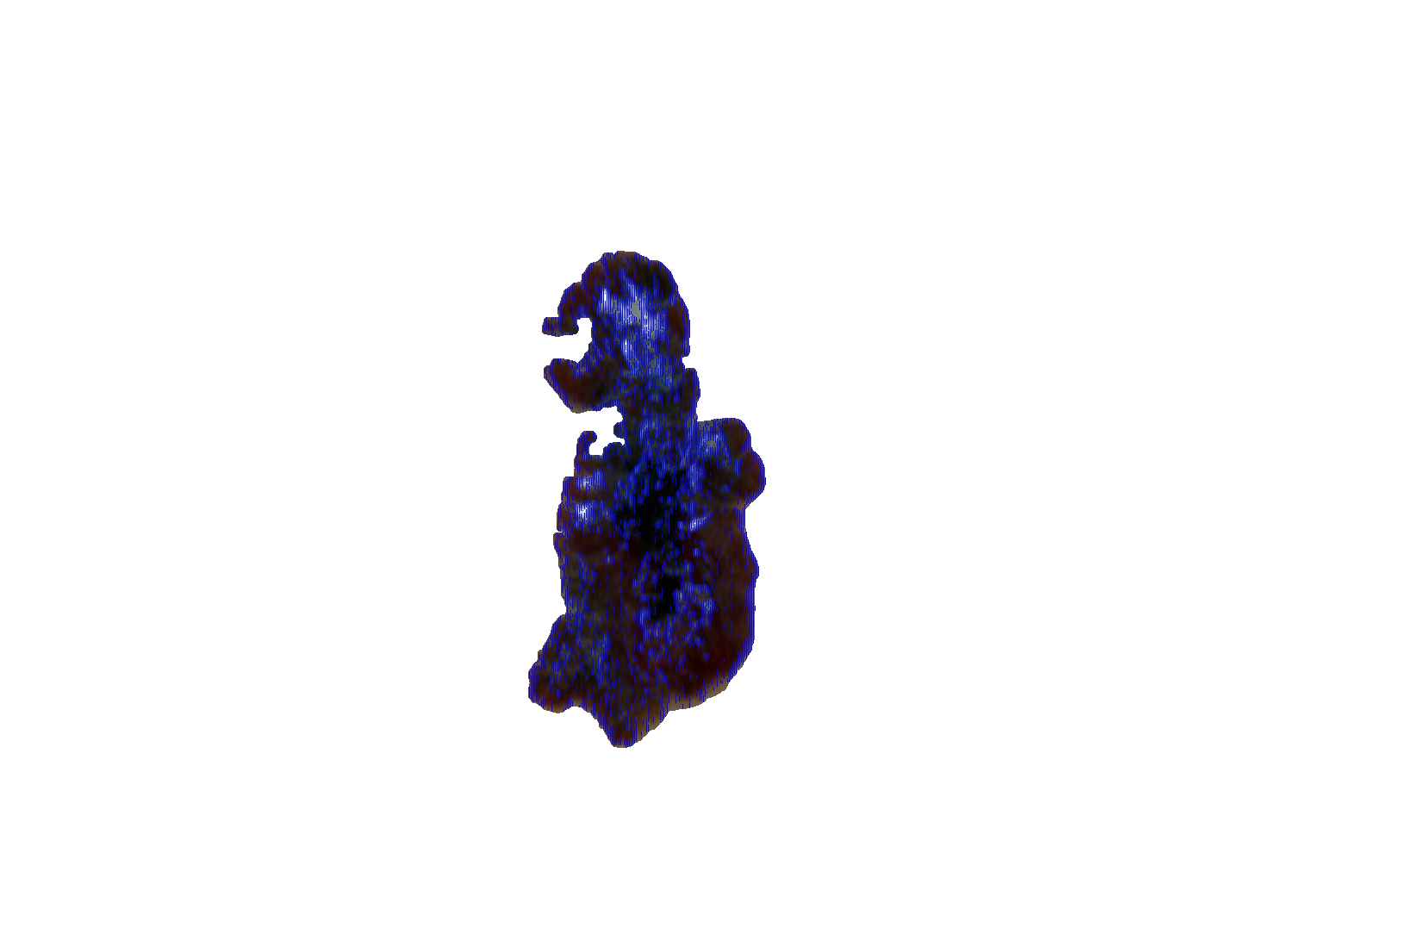
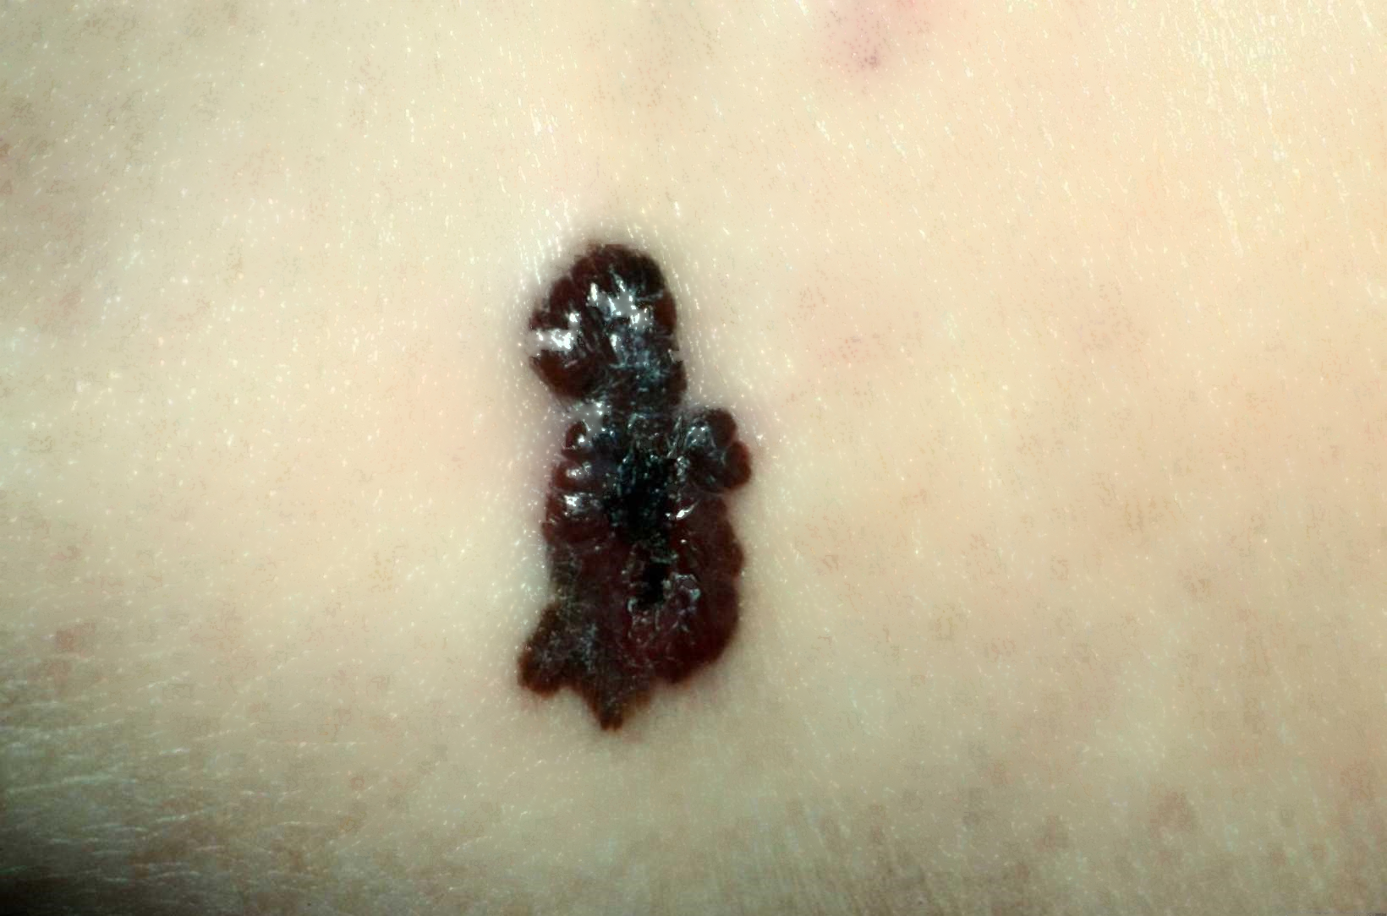
Diagnosis Process – Parallel Ridges
Parallel ridges are just the appearance of ridges along a melanoma lesion.
Was combined with reticular shape as the shape of parallel ridges matches that of a net/web
Did a similar measurement to pigment color but instead checked the change is color between pixels 2 points away from each other
Did this to get remove any progression in the shading as well as account for the blur applied at preprocessing
Decided that if 15% of the legion were considered parallel ridges than this could be enough to denote their presence

Slide 11
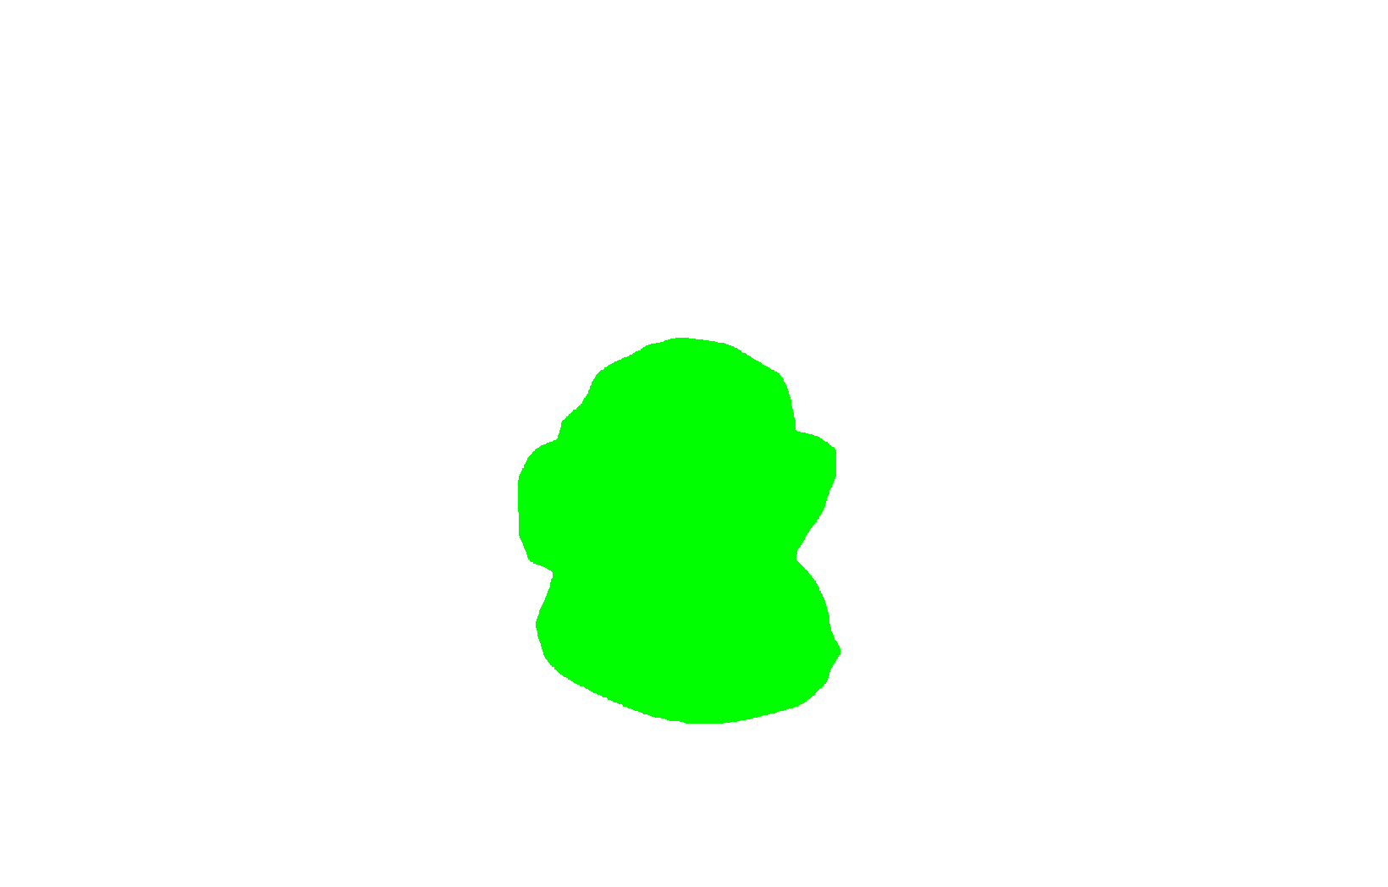
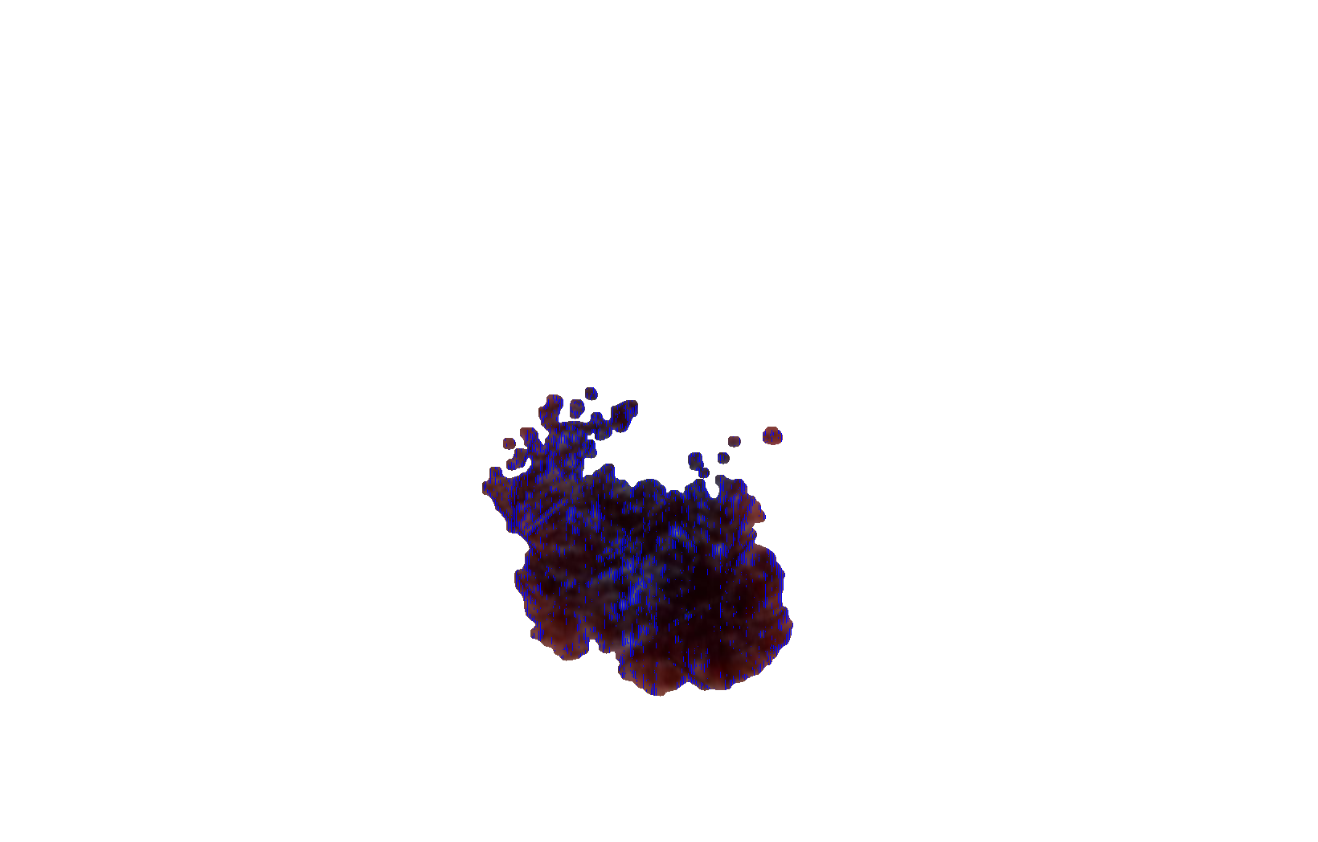
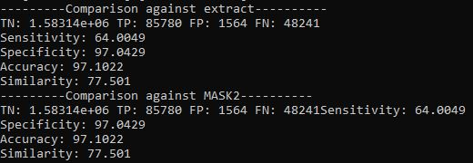
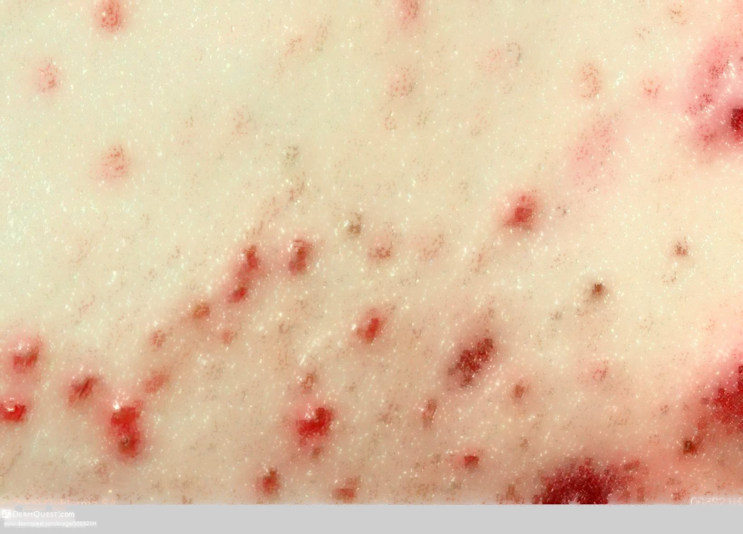
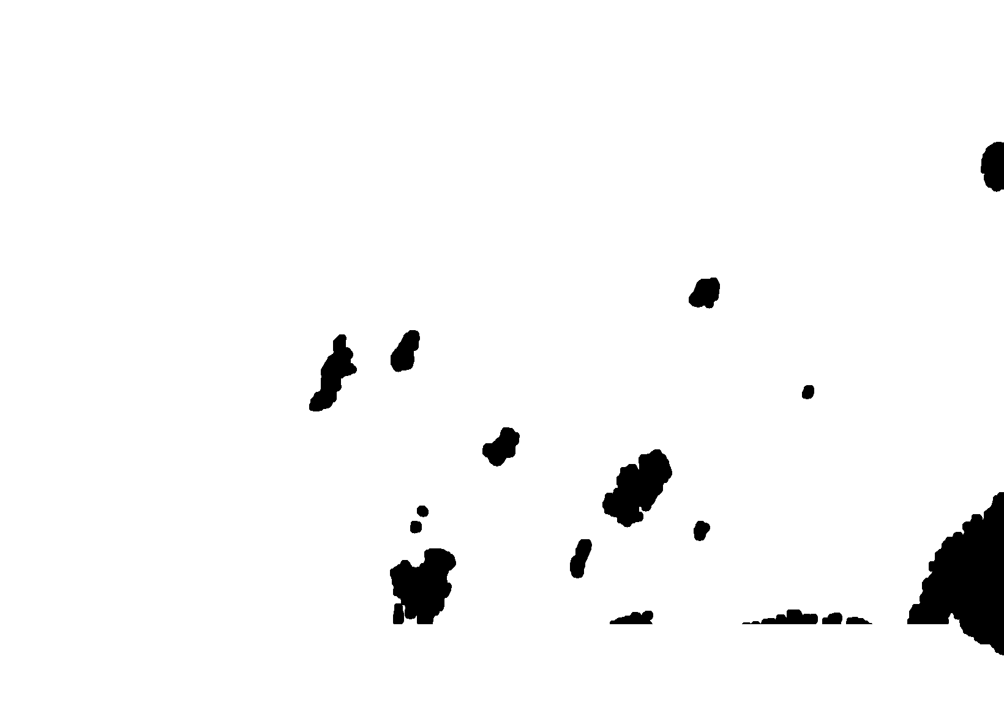
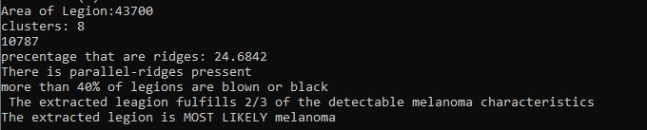
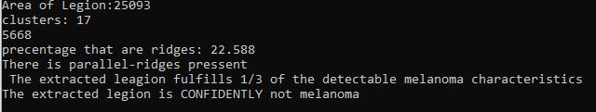
Final results
For the accuracy measurements I compared against both the mask, and the extraction against the ground truth.
Found that in most images the accuracy would be around the 90%-96% range
The worst measurement I had on any item was on an single images sensitivity which was 64%.
The Diagnosis worked well with the worst rating given to melanoma being MOST likely
All other melanoma images were identified and diagnosed correctly
Was also able to identify images that were not melanoma and identify them correctly

Slide 12
Potential issues and expansions
I am a bit worried about the ground truths as even though I created them manually as well as tried to be as accurate as possible, cannot be 100% confident in them
I am not a professional in either graphic software nor skin disease detection so I worry about some being too big.
Worries that the system may not be as robust as I hope as I was not able to test every image I wanted just because of the time the inpainting process takes.
Disappointed that I was not able to create the full skin disease Identification system I wanted, nor get as many patterns as I wanted
If I had to expand and work on this project more This in the main feature I would want to work on

Slide 13
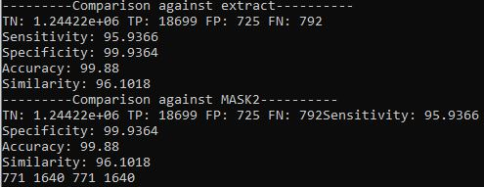
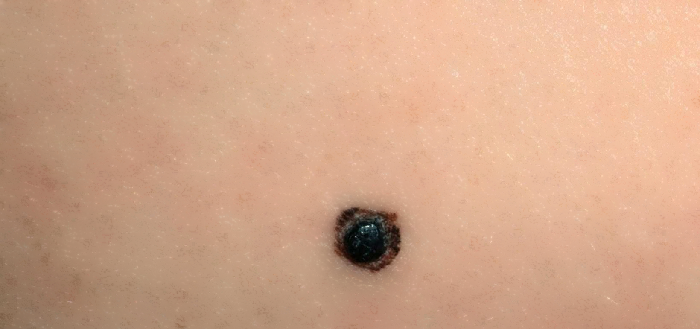
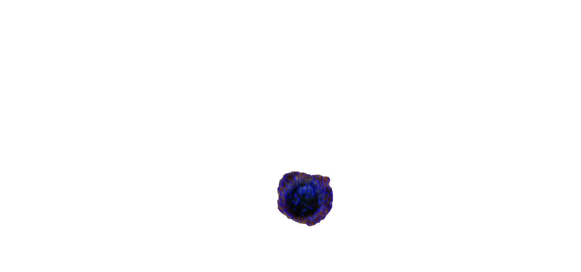
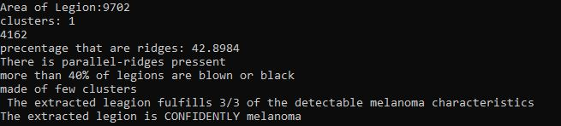
Conclusion
With the time allotted to us and the skill I had I am very pleased with the results of the project
The system is able to properly identify melanoma, as well as get good extraction of the legions
I have also learned a lot from the project
Experience in different color spaces
Cleaning noise and output results
Getting to do a true image processing workflow that had no real guide

Slide 14
References
[1] Zafar, K., Gilani, S. O., Waris, A., Ahmed, A., Jamil, M., Khan, M. N., & Sohail Kashif, A. (2020). Skin lesion segmentation from dermoscopic images using convolutional neural network. Sensors, 20(6), 1601. https://doi.org/10.3390/s20061601
[2] Garnavi, R., Aldeen, M., Celebi, M. E., Varigos, G., & Finch, S. (2011). Border detection in dermoscopy images using hybrid thresholding on optimized color channels. Computerized Medical Imaging and Graphics, 35(2), 105–115. https://doi.org/10.1016/j.compmedimag.2010.08.001
[3] Soyer, Peter & Argenziano, Giuseppe & Ruocco, V & Chimenti, Sergio. (2001). Dermoscopy of Pigmented Skin Lesions. European journal of dermatology : EJD. 11. 483-98.

